Slide 1
P07 Growing With Time
A113 – Mathematics

Slide 2
Scenario
John was researching on the growth in quantity of a certain type of micro-organisms.

Slide 3
Scenario
He recorded his experimental findings on their growth in quantity over a period of time, in Table 1.
He plotted out a graph of the quantity of the micro-organisms against time, in Graph 1.
From Graph 1, he realised that it was difficult for him to make accurate estimations of the quantity of the micro-organisms at certain time periods:
between 0 to 4 hours
beyond his data collection time period (e.g. after 6 hours)
Table 1
Time (hours) | Quantity (Q)
0 | 1
1 | 10
2 | 110
3 | 1,092
4 | 11,036
5 | 109,600
6 | 1,145,000

Slide 4
Scenario
Table 2
Time (hours) | lg Q
0 | 0
1 | 1
2 | 2.041
3 | 3.038
4 | 4.043
5 | 5.040
6 | 6.059
He applied the logarithmic scale to the quantity of micro-organisms, as shown in Table 2 and plotted Graph 2.
What are the benefits of representing John’s data in Graph 2 as compared to that of Graph 1?

Slide 5
Scenario
Given that ,
Investigate the time t, at which the quantity of the micro- organisms will reach 2000.
If a small amount of a certain substance was supplied to the micro-organisms at optimal temperature, the growth of the micro-organisms increases and the quantity of the micro-organisms can be described as
Investigate the time t, at which the quantity of the micro- organisms will reach 2000.

Slide 6
Scenario Definition Template
What do we know?
John is conducting research into the growth of micro-organisms.
Micro-organisms seem to multiply very rapidly.
etc
What do we not know?
The growth pattern of the micro-organisms.
What are the other factors that affect the growth pattern of the micro-organisms?
etc
What do we need to find out?
How do we find out the unknown information? Are there any mathematical formulae?
The time t, at which the quantity of the micro-organisms will reach 2000 with and without the substance added.
etc

Slide 7
Learning Objectives
Recognise the main characteristic of exponential growth pattern: proportion of growth for every fixed time interval is the same
Recognise the benefits of representing an exponential data in a logarithmic scale
Define a logarithmic function
Identify graphs of exponential and logarithmic functions
Apply laws of logarithm to solve equations involving logarithmic and exponential functions

Slide 8
Exponential Growth
An exponential growth is one in which the proportion in growth for every fixed time interval is the same.
In Table 1 of John’s collected data, the quantity of micro-organisms increases by a factor of about 10 for every 1 hour.
From 2 to 3 hours, the quantity increased by a factor of 1,092/110 ≈10
From 3 to 4 hours, the quantity increased by a factor of 11,036/1,092 ≈ 10
In other words, the growth of the micro-organisms resembles an exponential growth.
Time (hours) | Quantity (Q) | Number of times the quantity increased
0 | 1 | -
1 | 10 | = 10/1 = 10
2 | 110 | = 110/10 ≈ 10
3 | 1,092 | = 1,092/110 = 9.927 ≈ 10
4 | 11,036 | = 11,036/1,092 =10.106 ≈ 10
5 | 109,600 | = 109,600/11,036 = 9.931 ≈ 10
6 | 1,145,000 | = 1,145,000/109,600=10.447 ≈10
+1
×10
+1
×10

Slide 9
Introduction to Logarithm
After applying logarithmic scale to the quantity of micro-organisms in Table 1, the values in Table 2 are obtained.
Table 1
Table 2
Time (hours) | lg Q
0 | 0
1 | 1
2 | 2.041
3 | 3.038
4 | 4.043
5 | 5.040
6 | 6.059
Time (hours) | Quantity (Q)
0 | 1
1 | 10
2 | 110
3 | 1,092
4 | 11,036
5 | 109,600
6 | 1,145,000

Slide 10



Introduction to Logarithm
What is Logarithm?

Slide 11

Definition of Logarithmic Function
An exponent is a way to show repeated multiplication. For example, , 4 is called the base of the exponent and 3 is called the exponent or power.
An exponential function is written this way:
where x is the exponent to which the base b must be
raised to produce y.
Logarithm function is the inverse of exponential function and the exponent, x can be found by using this:
where x is the logarithm of y to the base b
(where b > 0, b ≠ 1, y > 0)

Slide 12
Definition of Logarithmic Function
Commonly used values for base are 10 and e, where e ≈ 2.71828 (mathematical constant)
For example, to evaluate or ,
We press in the calculator to get about
0.30.
 | Logarithmic expression | Standard notation | Calculator
Common Logarithm
Natural Logarithm
log
ln
log
2

Slide 13

Test Yourself 1
Using calculator, evaluate the following logarithmic expressions:

Slide 14
Poll 1
Evaluate the following. Do they result in the same answer?
a) b)

Slide 15
Poll 2
Without using a calculator, can the following be evaluated?
a)
b)

Slide 16
Exponential and Logarithmic Graphs
For an exponential function (where a > 1):
y is always positive
When
For a logarithmic function (where a > 1):
x is always positive
When
y
(0, 1)
x
y
x
(1, 0)

Slide 17
Laws of Logarithm
Changing Logarithmic form to Exponential form
Logarithm of Base and Logarithm of 1
Power Law
Product Law and Quotient Law
Change of Base

Slide 18
Changing Logarithmic form to Exponential form
The logarithmic form can be changed to the exponential form as follows:
Example:
Given that , find the value of x.

Slide 19
Test Yourself 2
Given that , find the value of x.
Given that , find the value of y.

Slide 20
Logarithm of 1 & Logarithm of Base
Since ,
will result in:
will result in:
These are important results in logarithmic functions.

Slide 21
Test Yourself 3
Evaluate the following logarithmic expressions:
Note:

Slide 22
Product Law & Quotient Law
If b, m, n are positive numbers and , then
Product Law:
Quotient Law:
Example: Evaluate

Slide 23
Think Pair Share (5 min)
Without working out the answers, discuss with the person beside you, if the following statement is true or false:
The product law allows us to work out the below equations as shown.

Slide 24
Think Pair Share (5 min)
Using the _________, the equation is ________
The ________________________to this equation. Hence the statement is _______.

Slide 25
Test Yourself 4
Given that , find the value of A.
Given that , find the value of B.

Slide 26
Power Law
x times
x times
Example:
Given that , find the value of p.

Slide 27
Test Yourself 5
Given that , find the value of x.
Given that , find the value of y.

Slide 28
Change of Base
To change the base of a logarithmic function from b to new base m:
This allows us to use a calculator to evaluate a log to any base other than 10 or e.
Example:

Slide 29
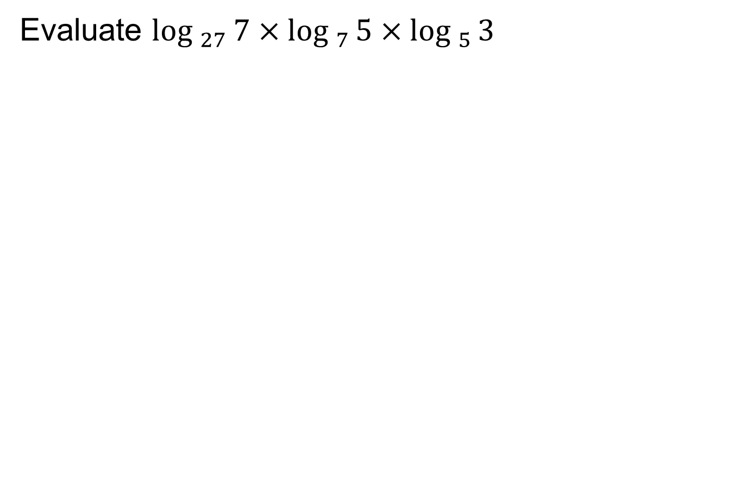
Test Yourself 6
Evaluate

Slide 30
Using Logarithm to Solve Equation
Consider the following equation:
To solve for x, you have to find out what exponent 3 has to be raised to produce 5
Since and , x is not an integer
Hence, logarithm needs to be used to find x:
Take common logarithm of both sides
Apply Power Law

Slide 31
Using Logarithm to Solve Equation
Consider another equation involving e:
Recall that
Hence, taking natural logarithm of both sides results in a simpler equation to solve for x:
Take natural logarithm of both sides
Apply Power Law

Slide 32
Test Yourself 7
Given that , find the value of x.
Given that , find the value of x.

Slide 33
Summary of Logarithmic Rules
Changing Logarithmic form to Exponential form
Logarithm of 1
Logarithm of Base
Product Law
Quotient Law
Power Law
Change of Base

Slide 34
One-Minute Write
Please produce a written response of either of the following in only one minute:
Identify what you found the most complex point is from the seminar, or
Write down a question you have with respect to the concepts learnt so far.

